Slide 1
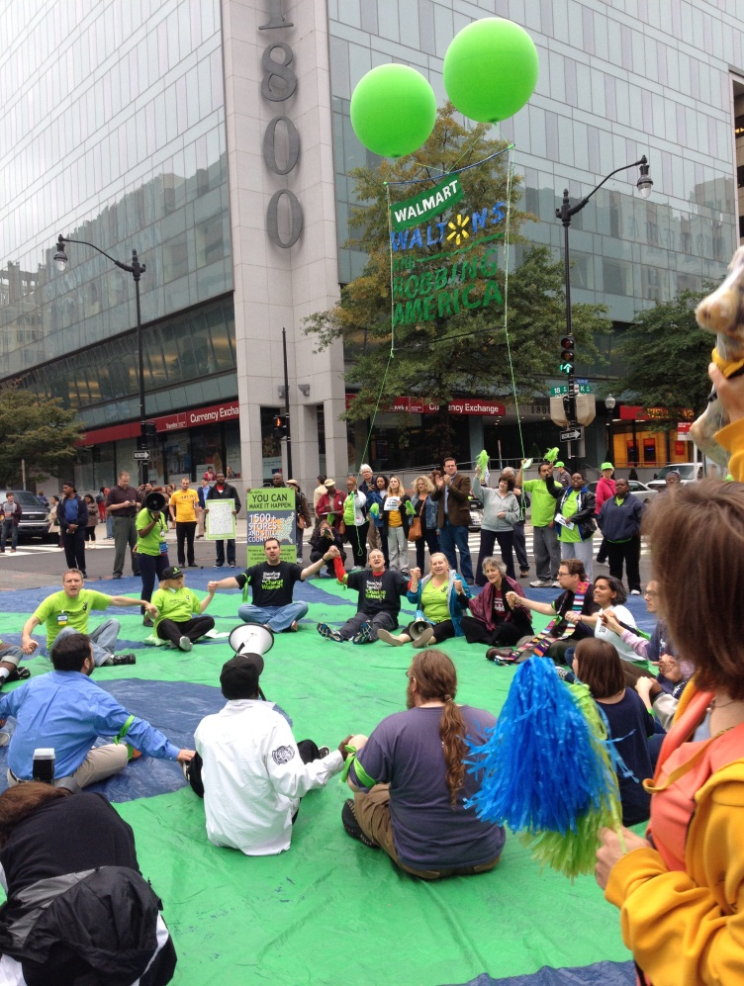
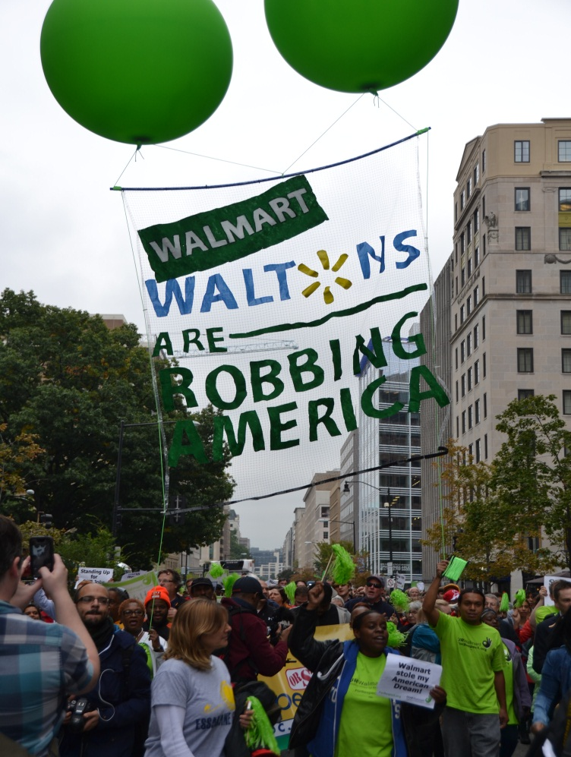
BLACK FRIDAY WALMART PROTEST
When: DAY, DATE at TIME
Where: LOCATION
What: DESCRIPTION OF THE EVENT GOES HERE
Name of Event Goes Here
http://blackfridayprotests.org/actions
#WalmartStrikers
LEGAL DISCLAIMER: UFCW and OUR Walmart have the purpose of helping Wal-Mart employees as individuals or groups in their dealings with Wal-Mart over labor rights and standards and their efforts to have Wal-Mart publically commit to adhering to labor rights and standards. UFCW and OUR Walmart have no intent to have Walmart recognize or bargain with UFCW or OUR Walmart as the representative of Walmart employees.

