Slide 1
Notes:
Mathew Palmer

Slide 2
Overview of the Durham Safe Routes to School Program
February 10, 2022

Slide 3
Agenda
Introduction of Multimodal Transportation at DPS
History of SRTS / Walking & Biking at DPS
Bike Durham Presentation
Considerations & Questions
Notes:
Mathew Palmer

Slide 4
Bike durham presentation

Slide 5
Safe Routes to School Program
Started as a volunteer-led effort
In 2019, City of Durham applied and received NCDOT funding for a three-year program
In 2021, City of Durham solicited proposals and awarded a contract to Bike Durham to manage the program
Walk & Bike to School Promotion
Bicycle Safety Skills Instruction for 4th and 5th grade students
Staff-level Oversight from City of Durham Transportation Department and Durham Public Schools Operations

Slide 6
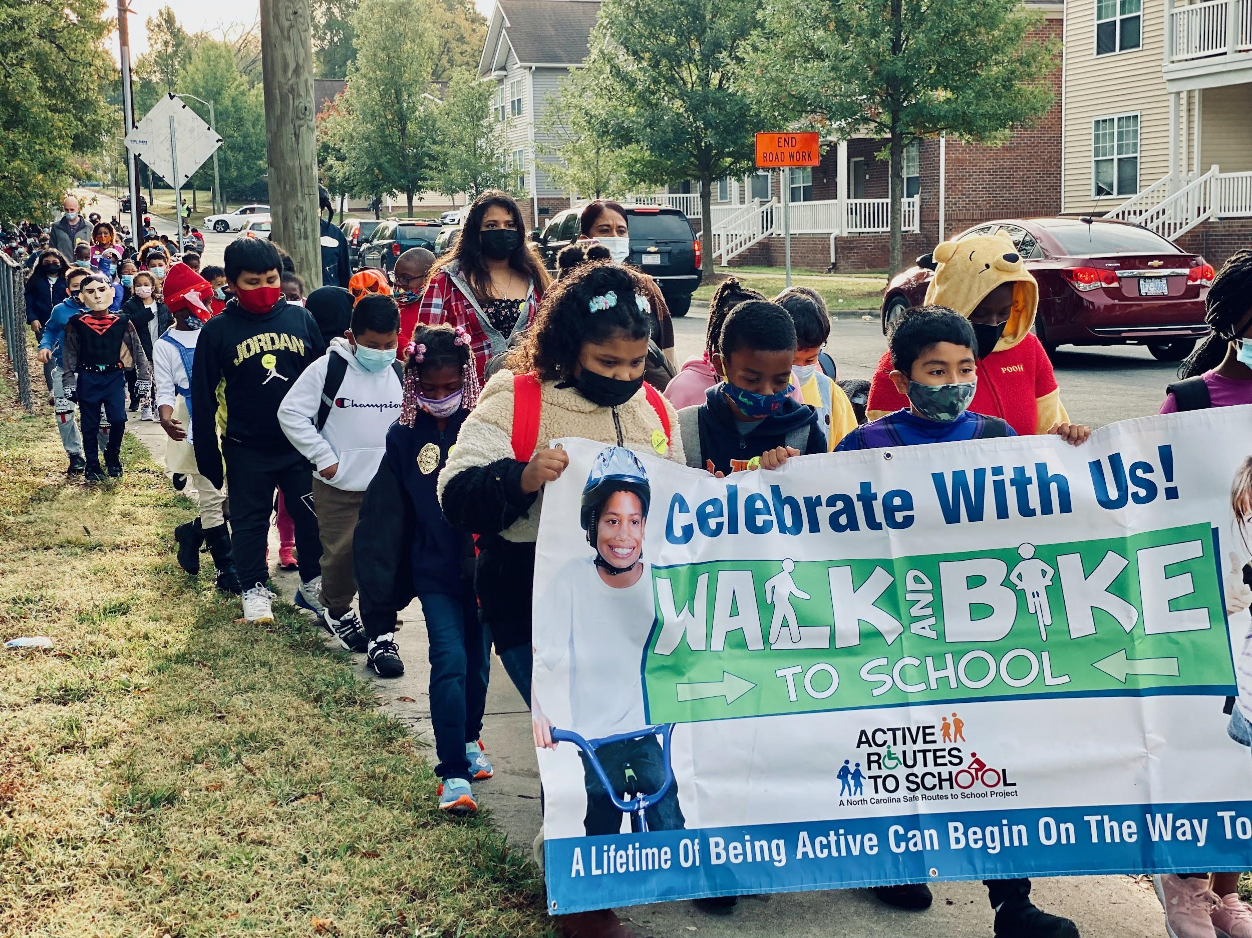
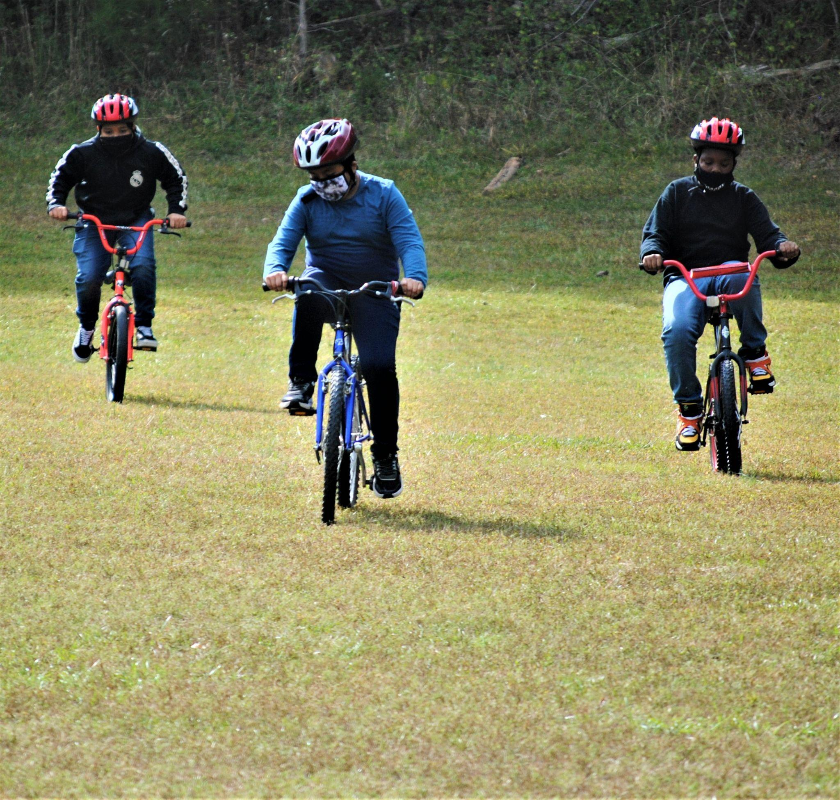
Safe Routes to School Program
Walk & Bike to School Events
Bike Safety Classes

Slide 7
Bike Durham
VISION
Everyone should have access to safe, affordable, and sustainable transportation, regardless of who they are or where they live.
MISSION
Through events, advocacy and education, we empower all people to walk, bike, and use transit more often.

Slide 8
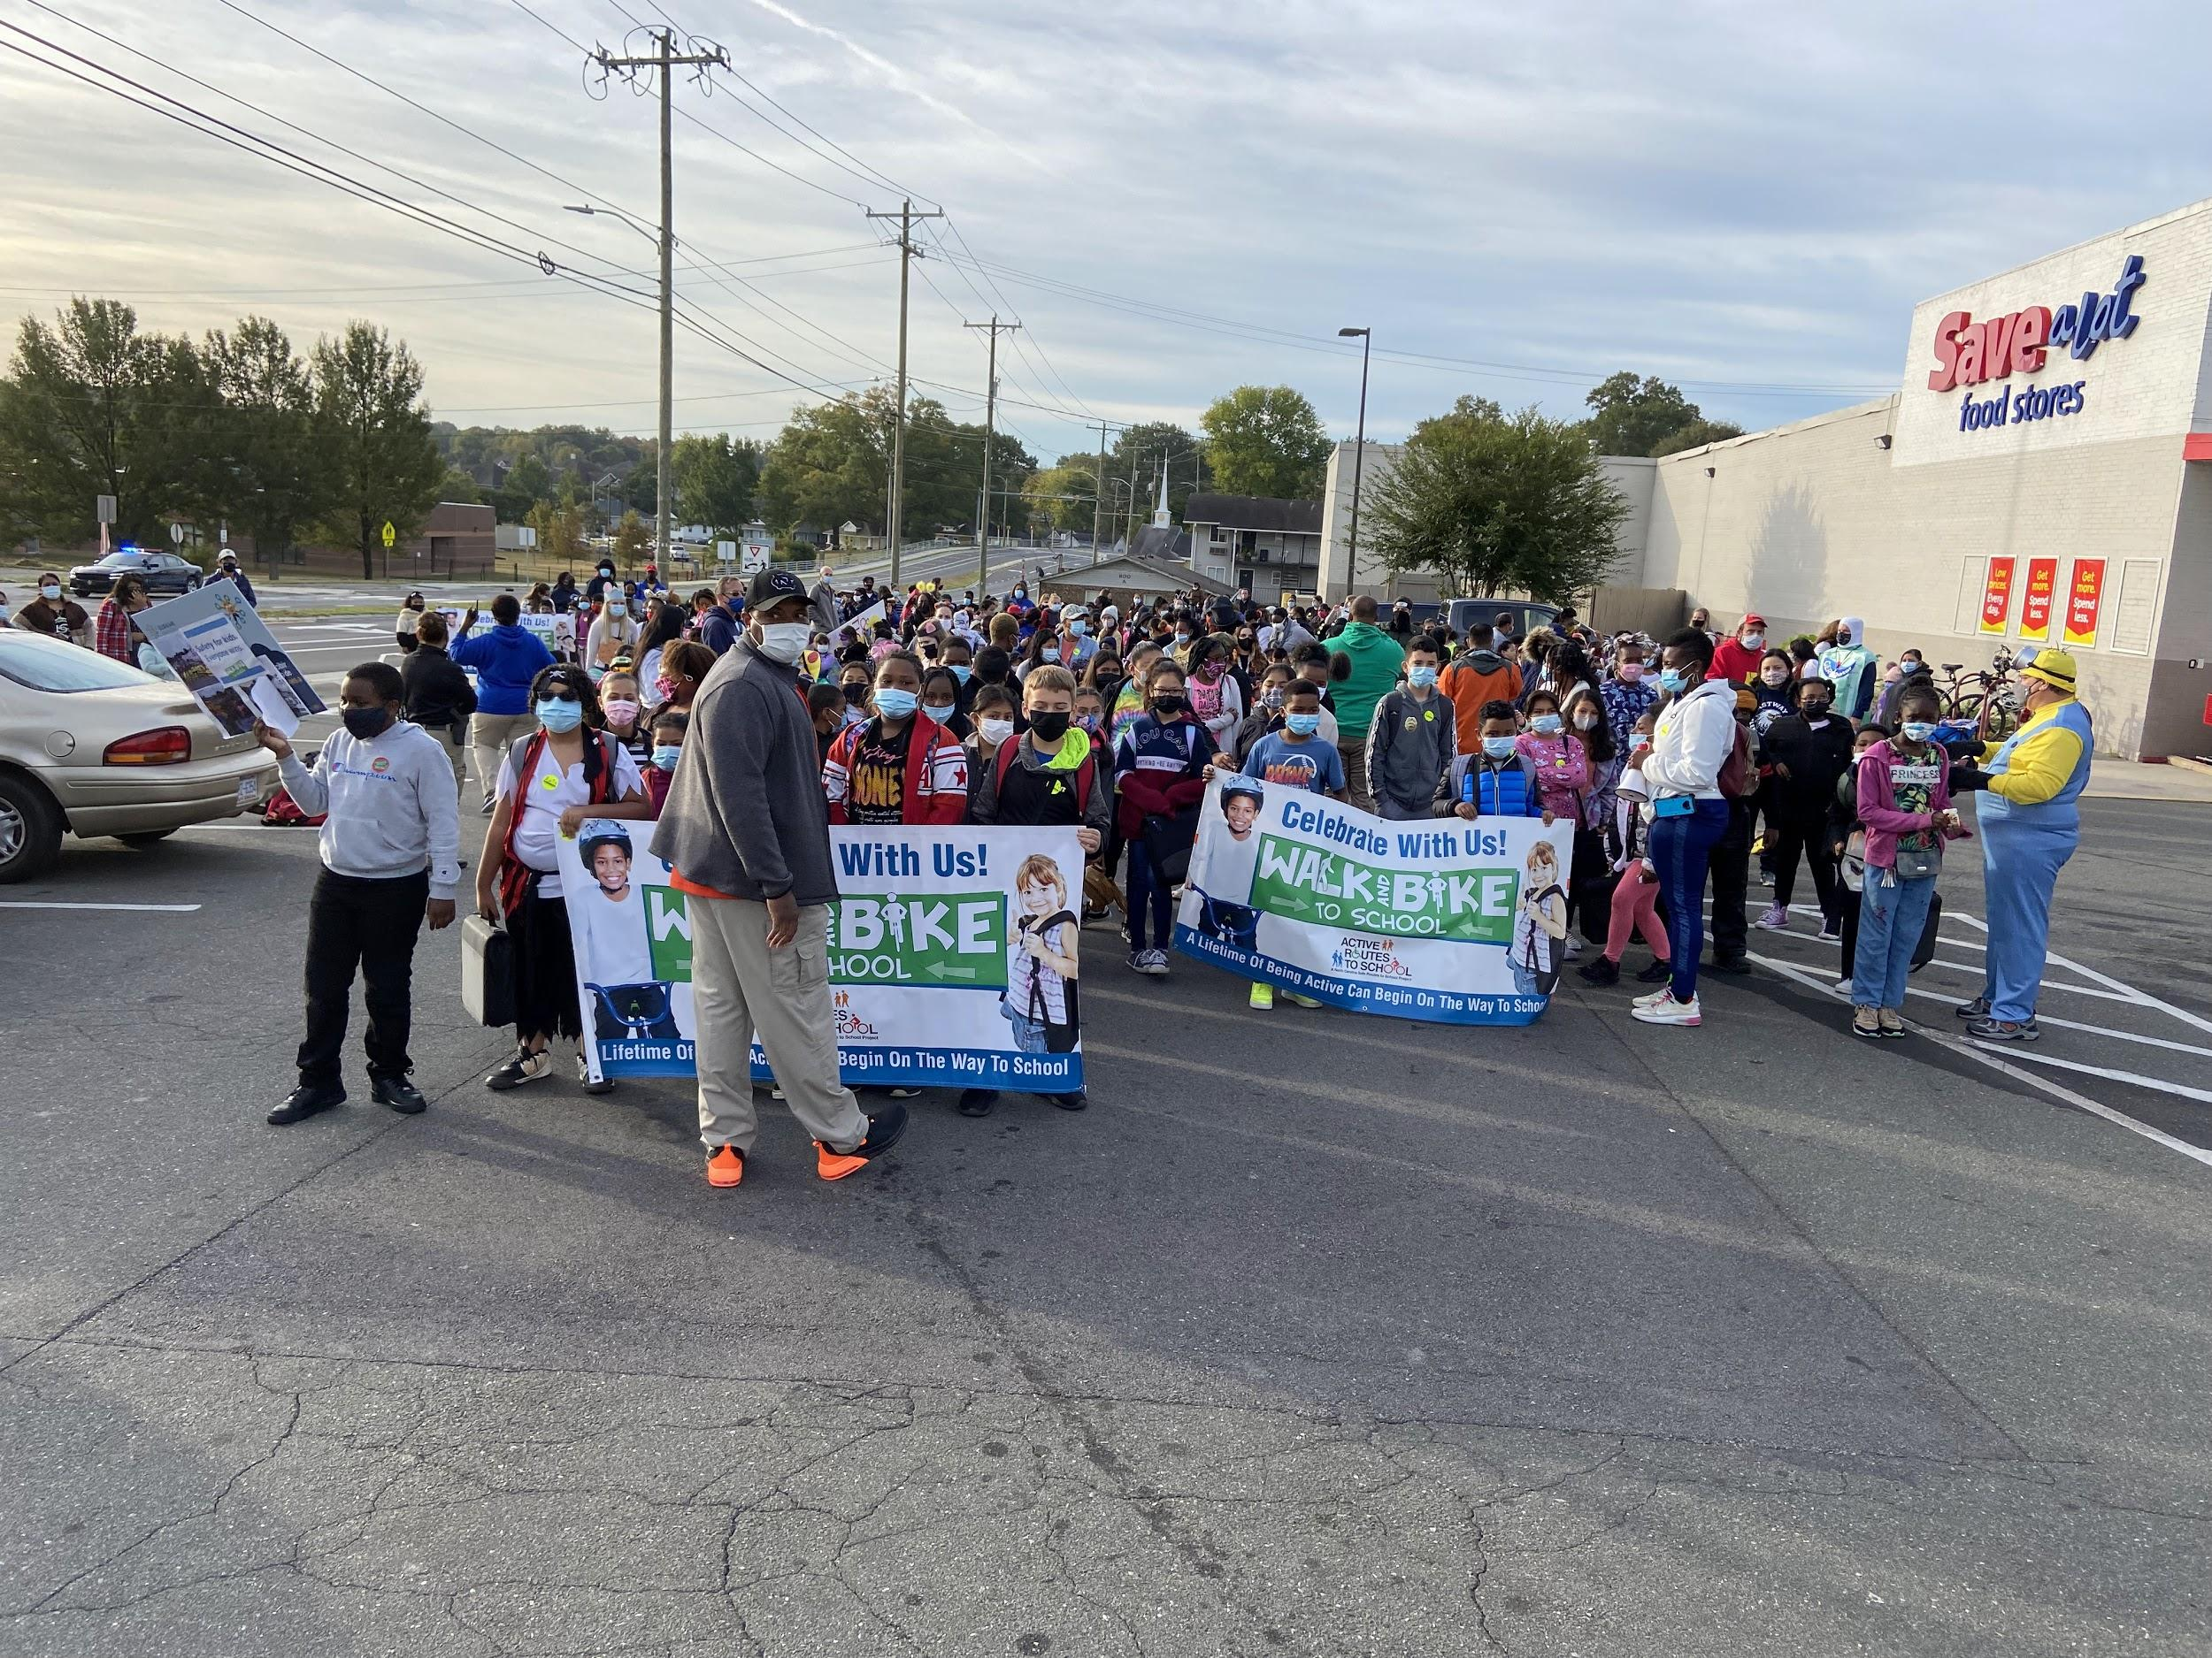
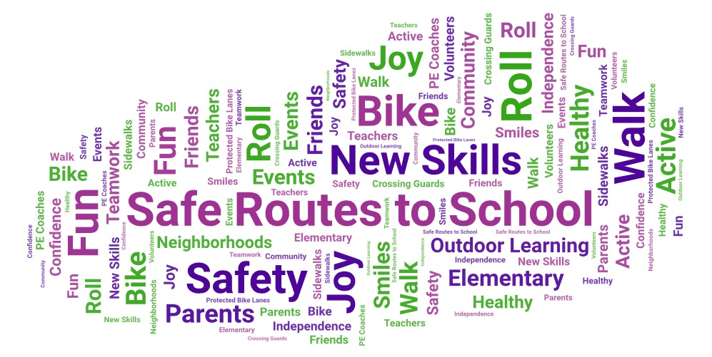
Walk & Bike to School Events
In October 2021, 13 Elementary DPS participated including more than 5,000 students.
For more info visit bikedurham.org/safe-routes-to-school
Notes:
Events are a wonderful way to celebrate the joy and independence of walking, biking & rolling to school and they bring schools and communities together for a common purpose. Most of all, they are fun!
U.S. Department of Health and Human Services recommends that children and adolescents get one hour or more of physical activity each day. Research suggests that physically active kids are more likely to become healthy, physically active adults, underscoring the importance of developing the habit of regular physical activity early.

Slide 9
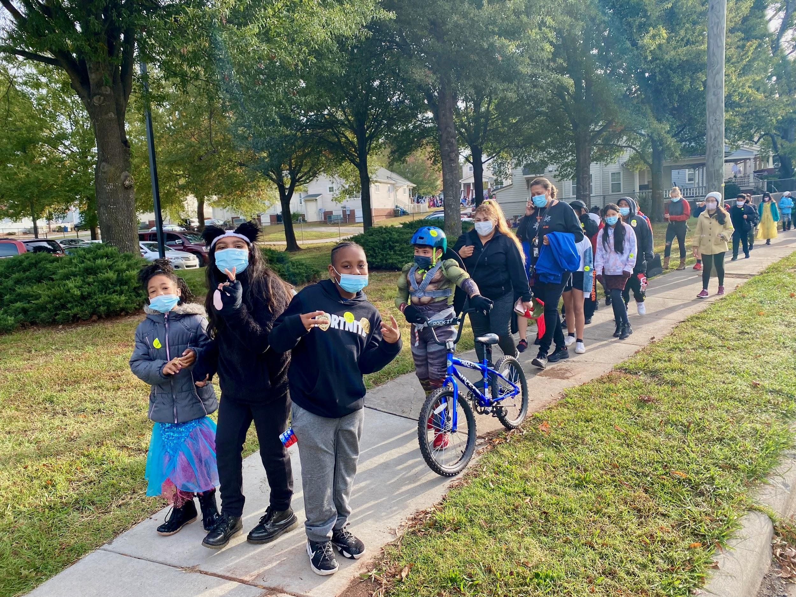
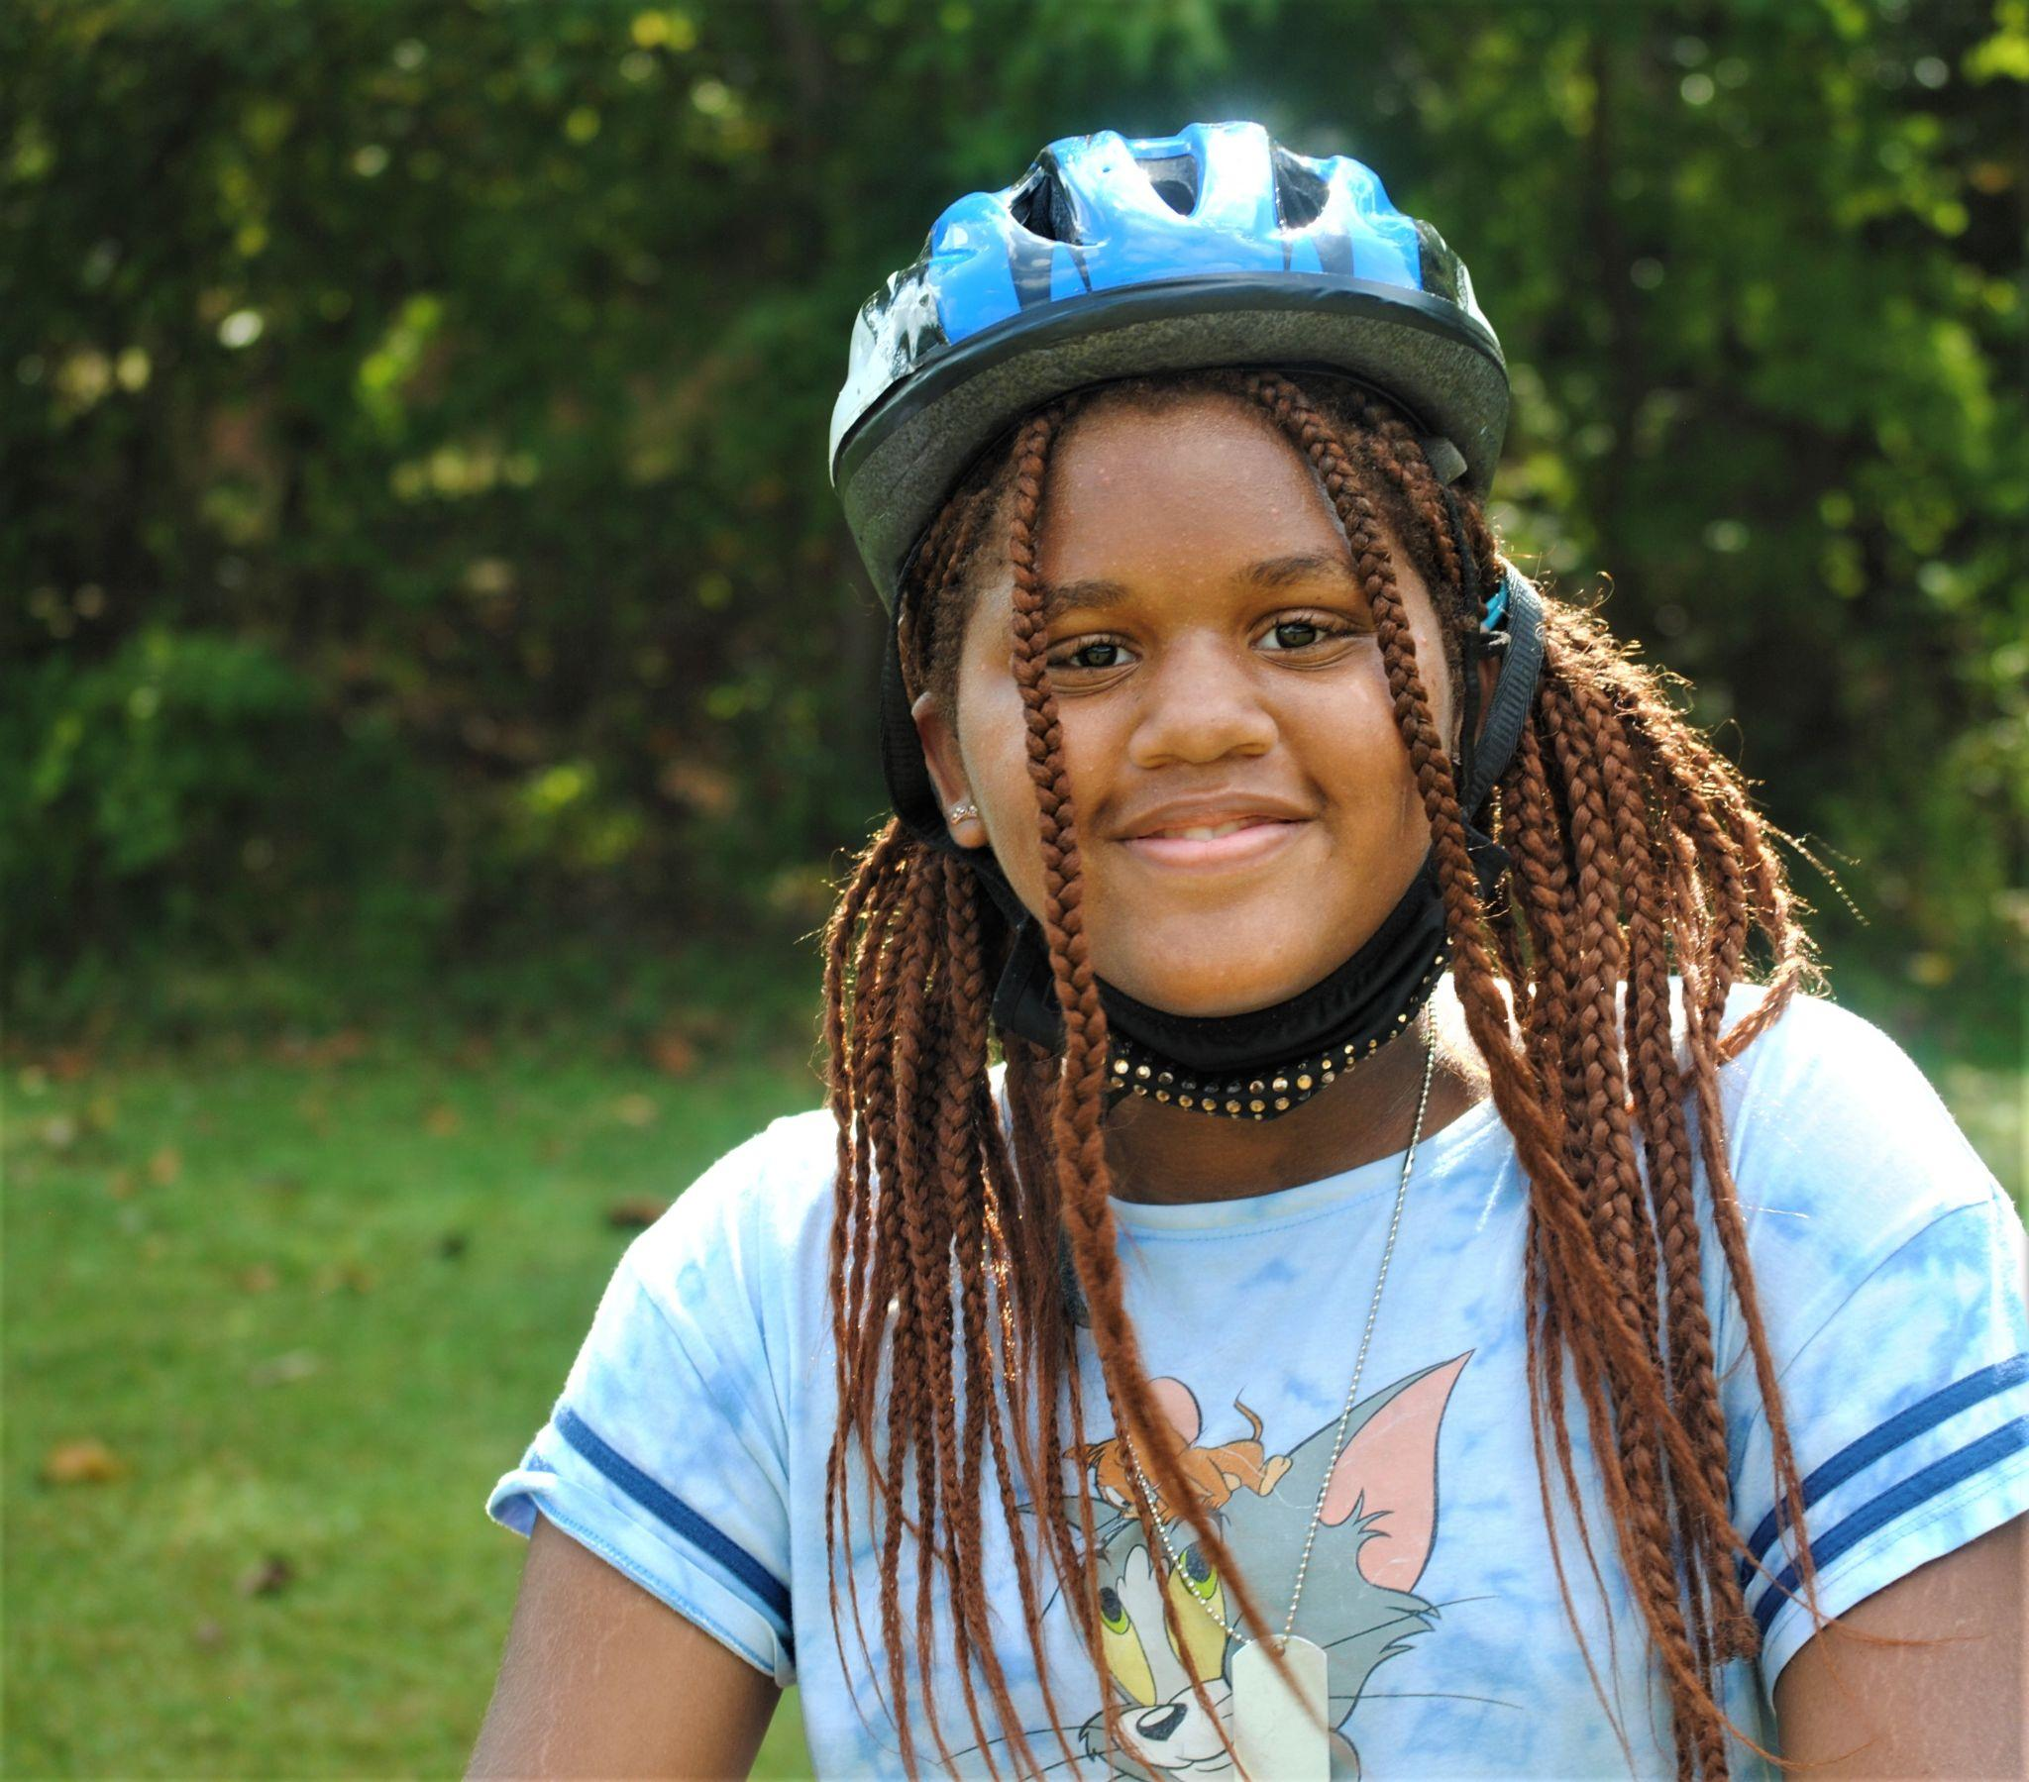
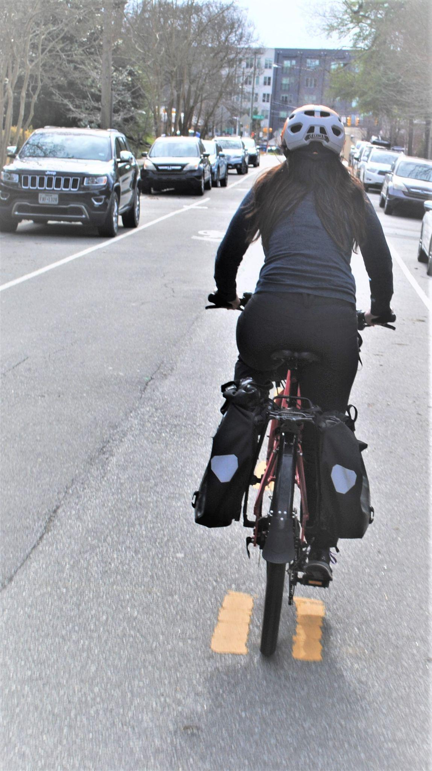
Walk & Bike to School Events
Notes:
In October 2021, 13 schools participated including more than 5,000 students.

Slide 10
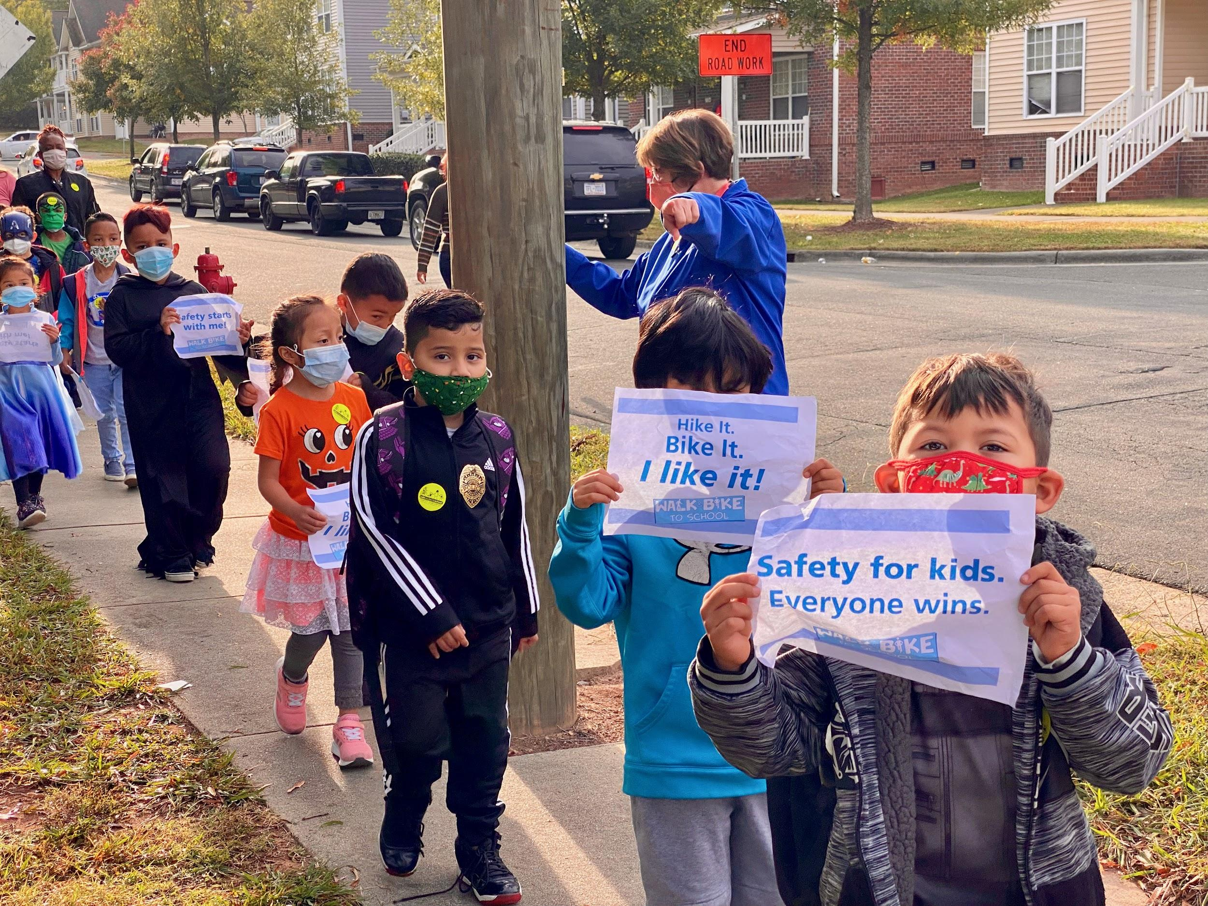
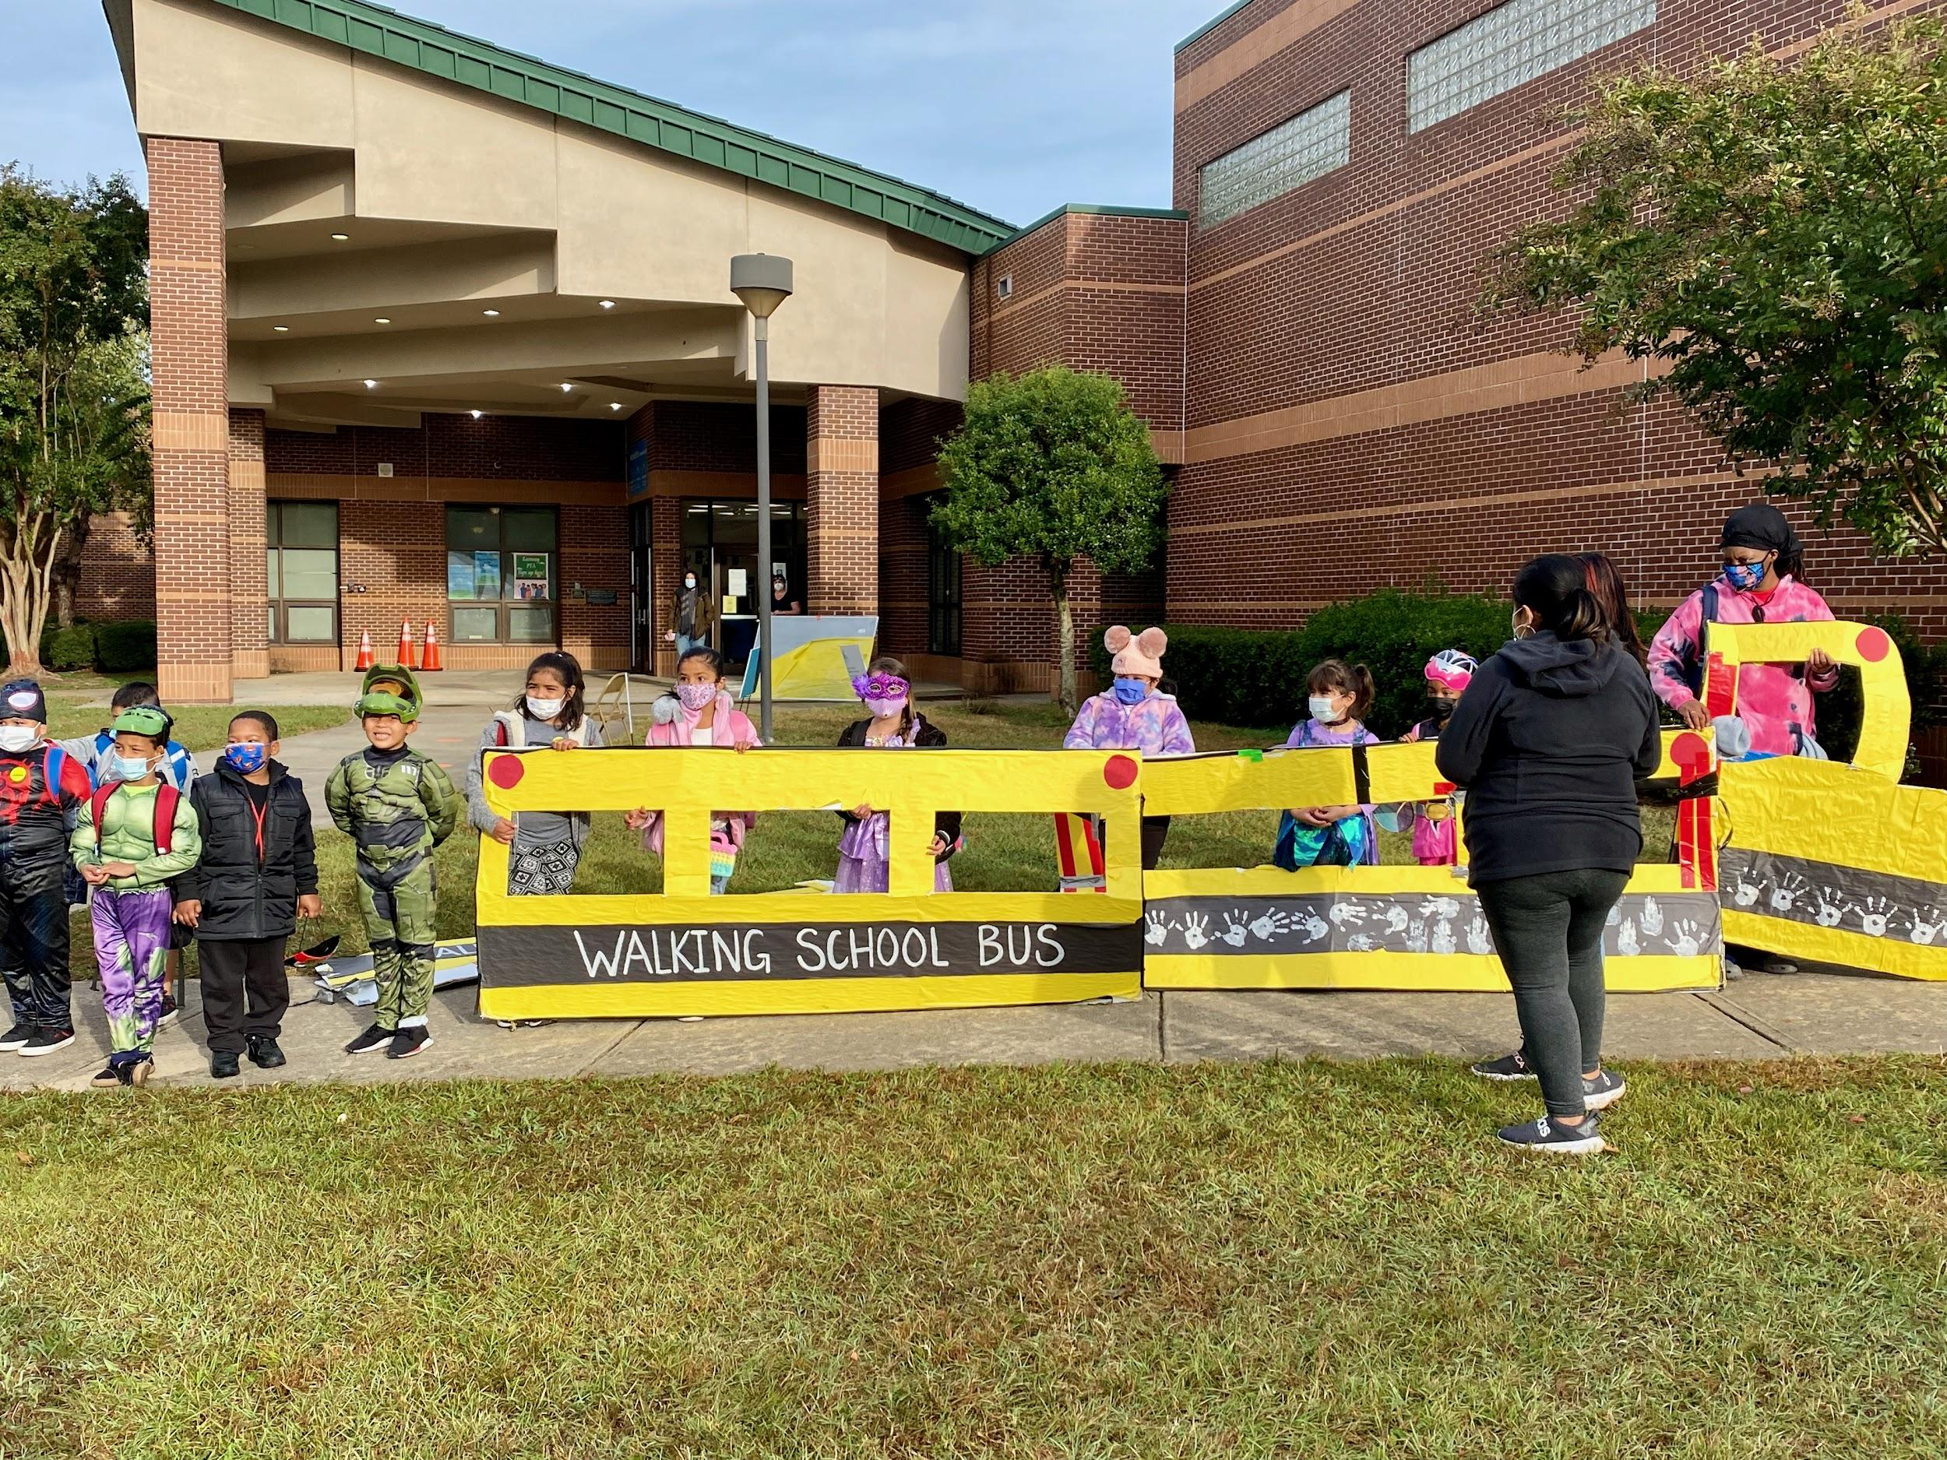
Walk & Bike to School Events
Walk & Bike to school - Eastway Elementary - October 28th
Notes:
This May, our goal is to have more than 7,500 students participate at 20 schools.

Slide 11
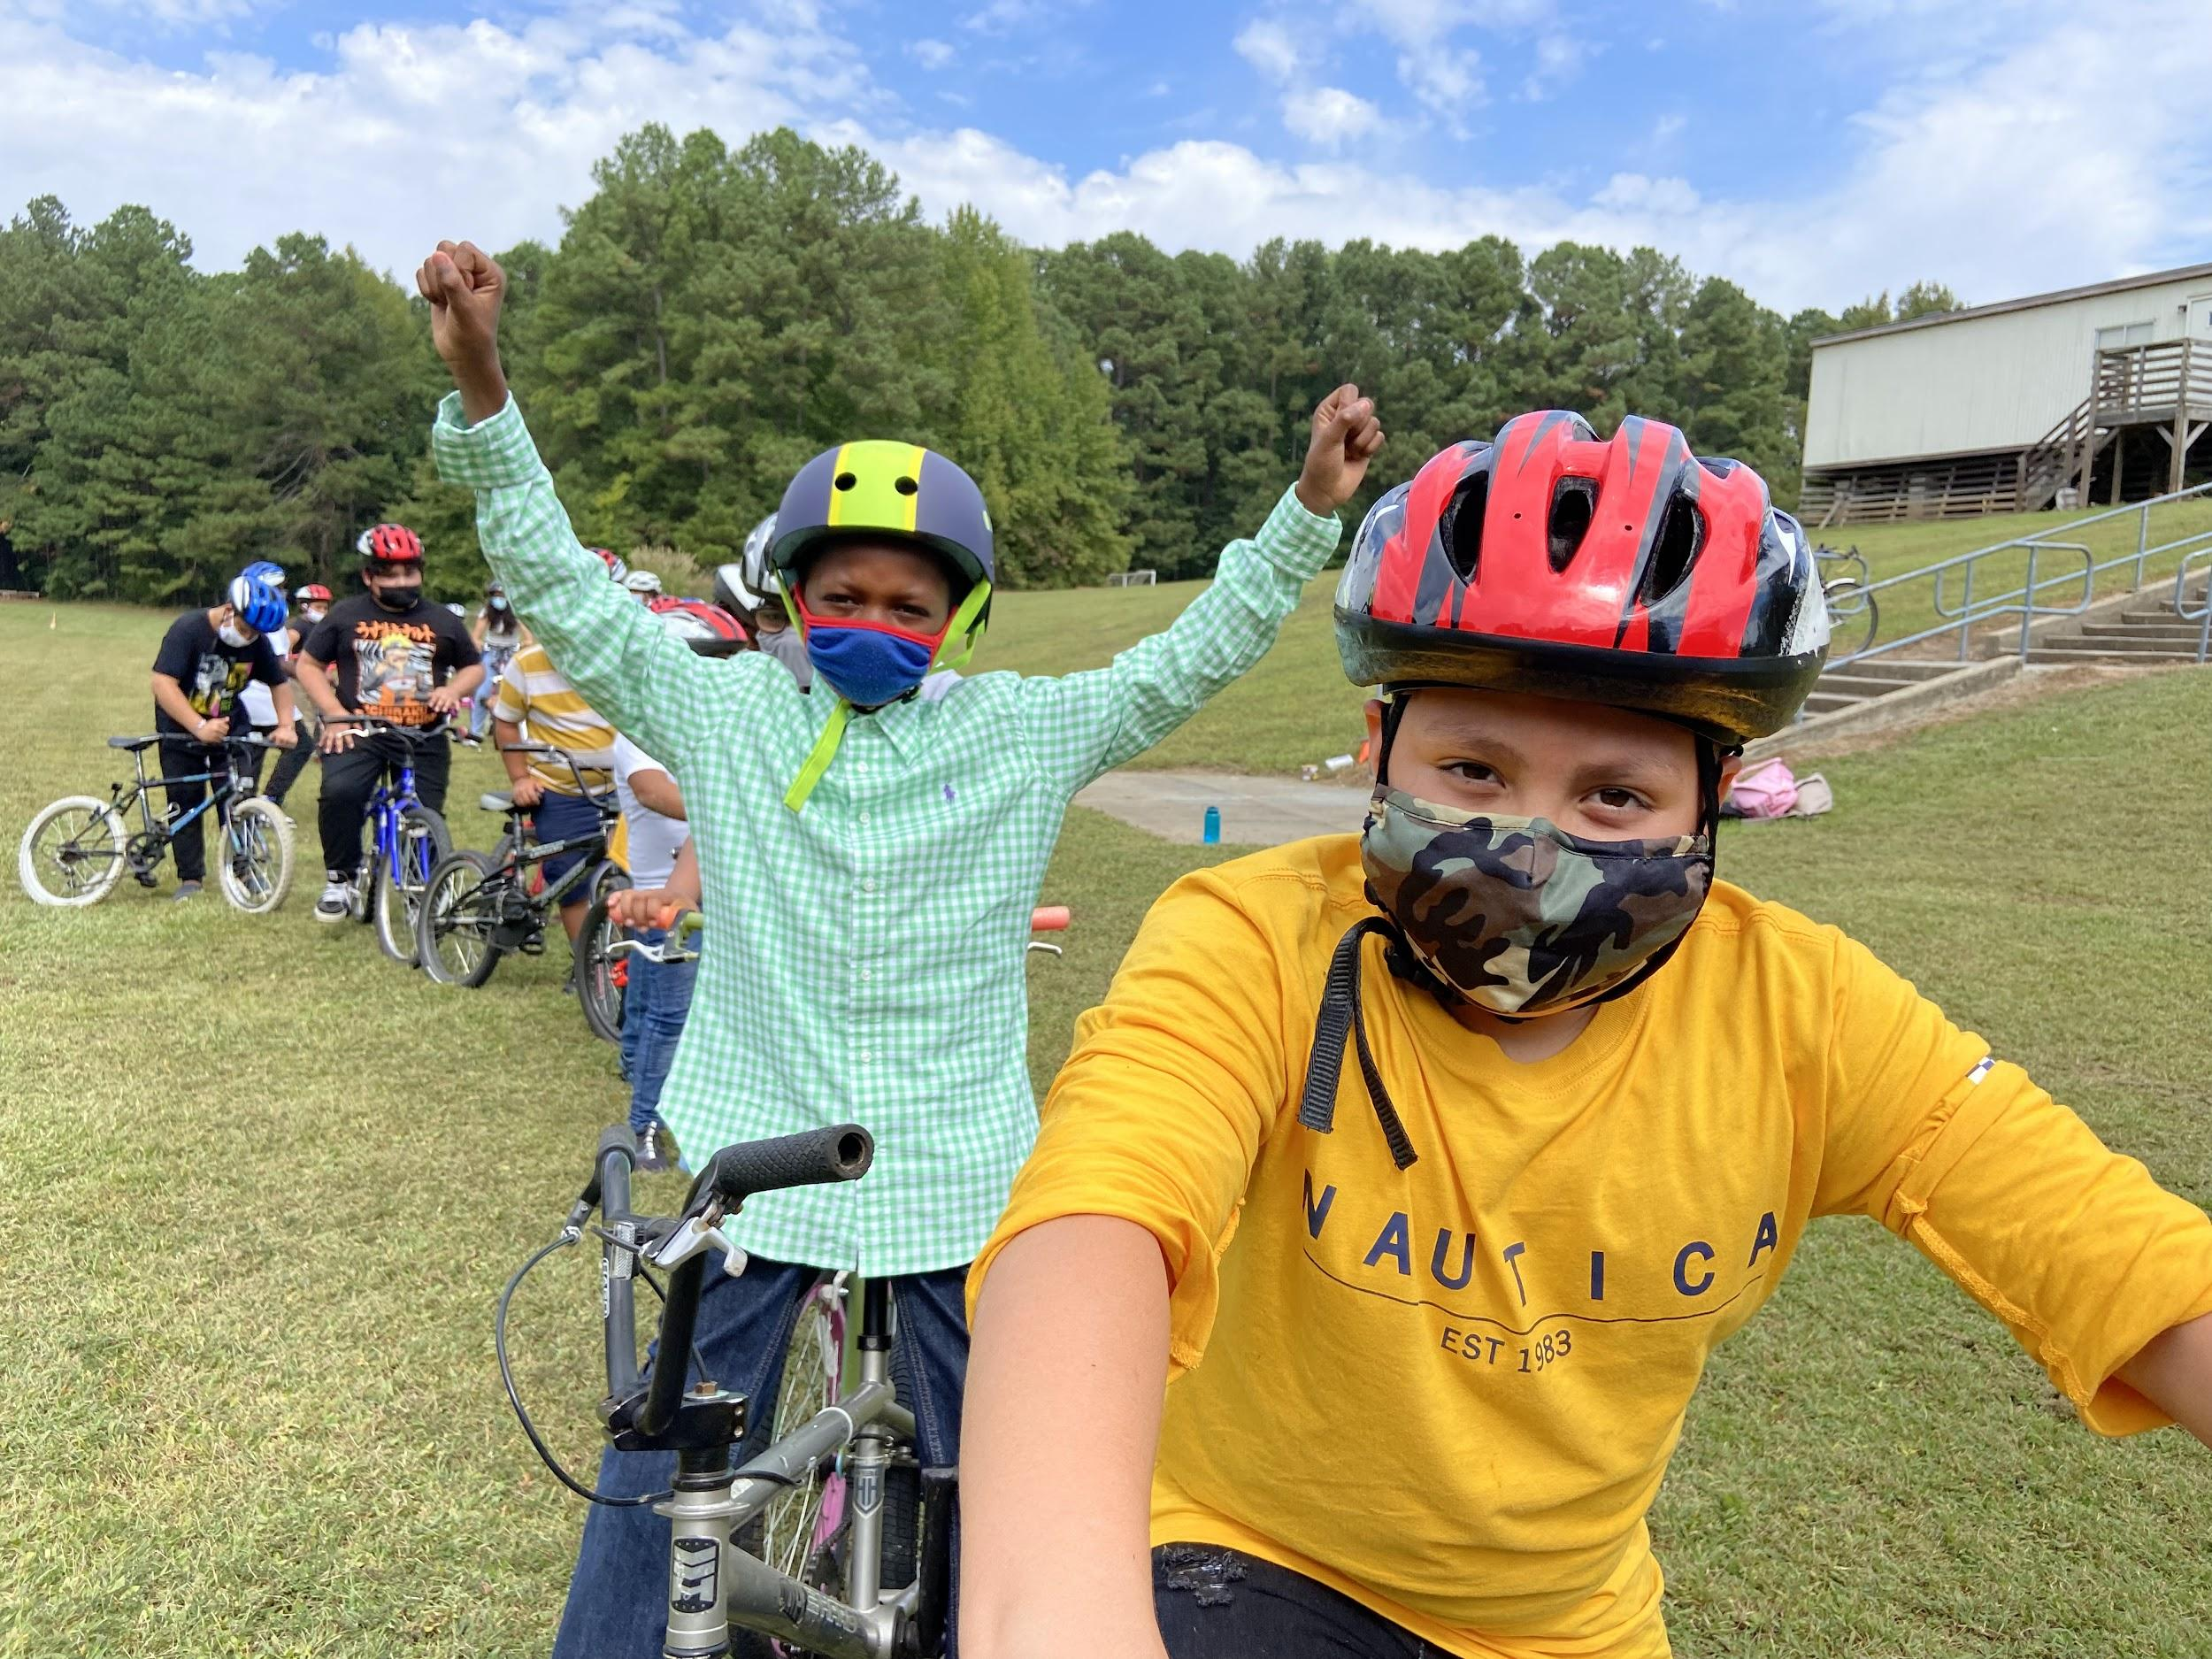
Bicycle Safety Course
A series of 4 classes that helps to give the students (4th or 5th graders) the tips, tools and techniques to safely wear a bike helmet, ride with balance on a bike and navigate through basic traffic. The course is taught in campus and not on the road.
Fall 2021 (completed)
Merrick-Moore, Spring Valley, and Eastway
Spring 2022 (planned)
Glenn, Creekside, Eno Valley, and YE Smith
Notes:
Our bike safety course is a series of 4 classes that helps to give the students (4th or 5th graders) the tips, tools and techniques to safely wear a bike helmet, ride with balance on a bike and navigate through basic traffic. The course is taught in campus and not on the road.
Bike Durham in partnership with the Durham Bike Coop has started a program called ‘Bikes Giveaway’, where we are able to provide free bikes, helmets and safety equipment to families in need.
Bike Durham in partnership with the Durham Bike Coop has started a program called ‘Bikes Giveaway’, where we are able to provide free bikes, helmets and safety equipment to families in need.

Slide 12
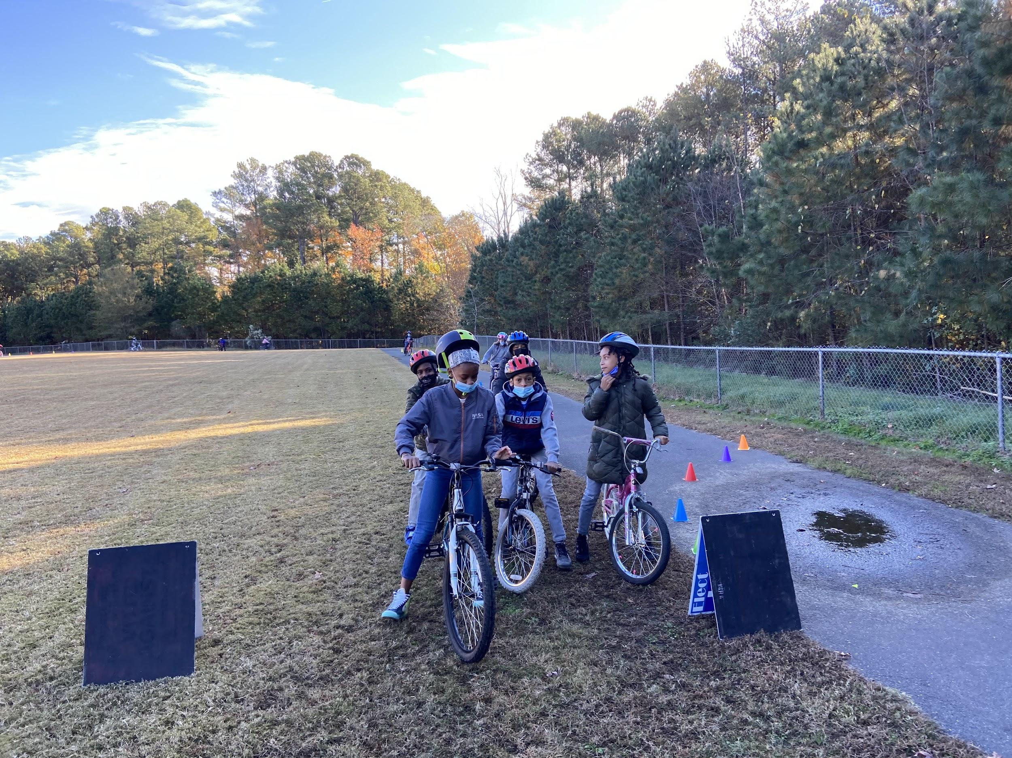
Bicycle Safety Course
The course covers the following topics:
Fitting a bike helmet
Stop signs and pedestrian crossings
Balance on the bike
Riding through obstacles
Bike Safety Check A-B-C (Air, Brakes, Chain)
Pumping a bike tire
Wearing safety equipment (lights and safety vest)

Slide 13
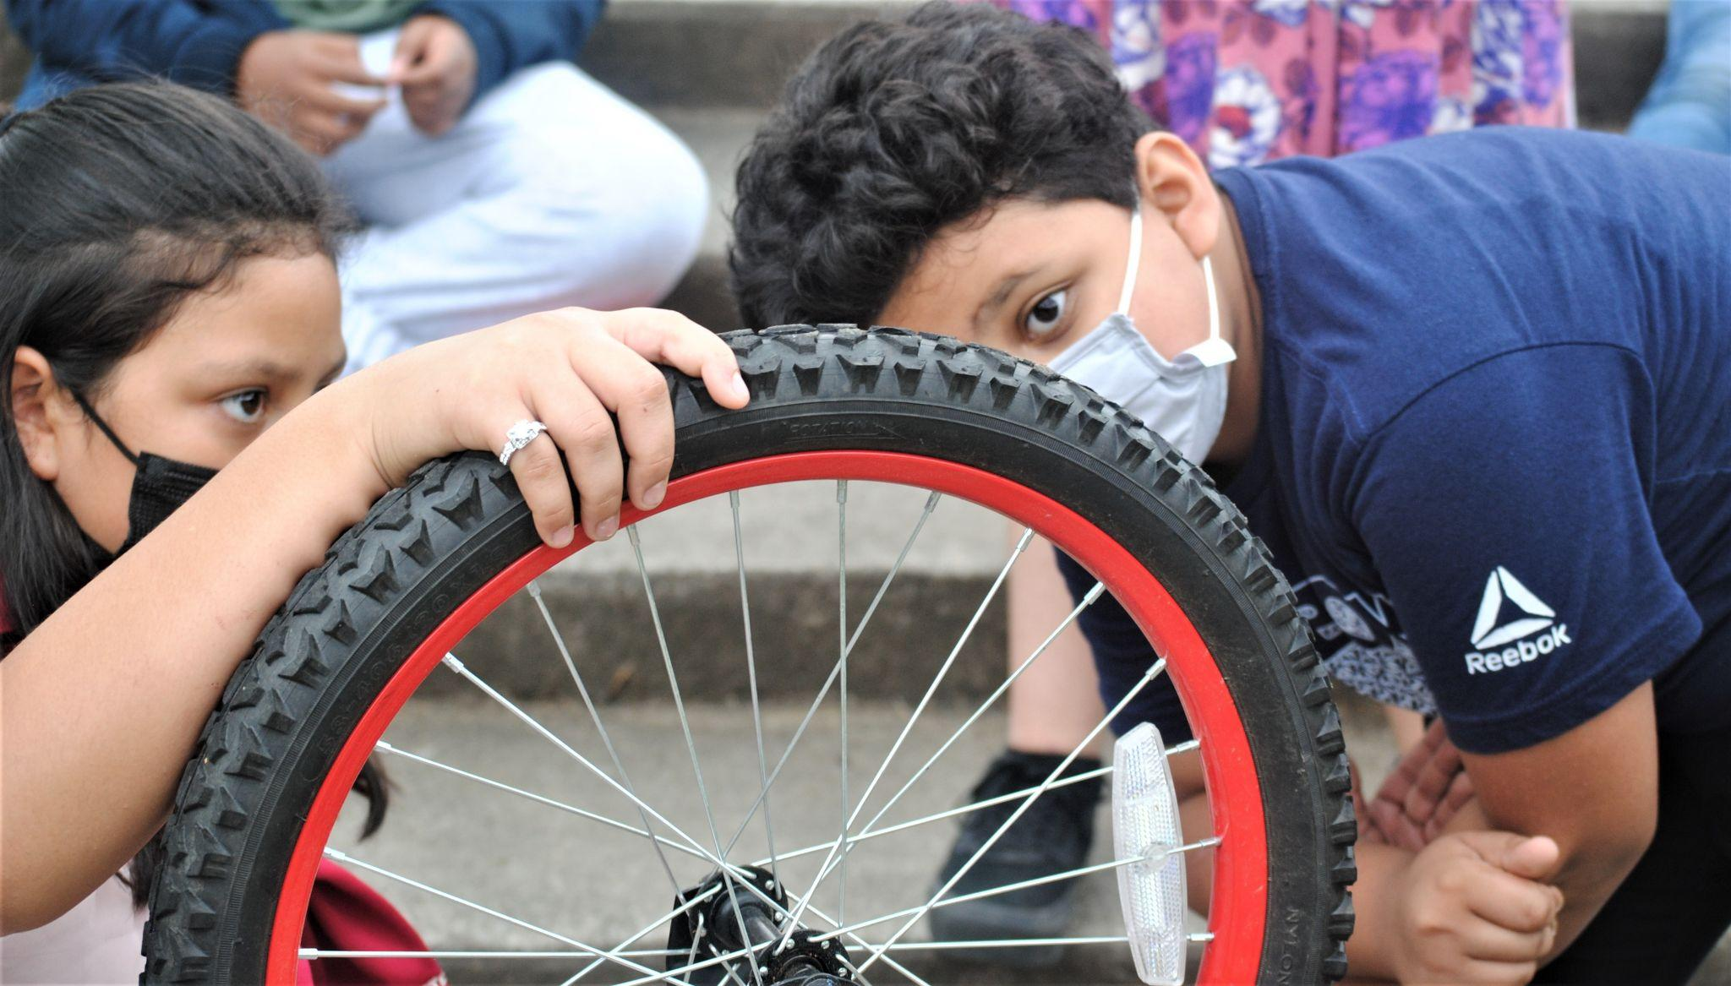
Bicycle Safety Course
I really liked learning about how to fit a helmet and why it is important. I never used to wear a helmet and now I do. I liked learning how to work on a bike, pump up tires, and look at the gears and chain. I bike more now since I took the class. I got my friends, family and cousins to start biking again. - Adrian Henandez, 5th grader at Merrick-Moore Elementary

Slide 14
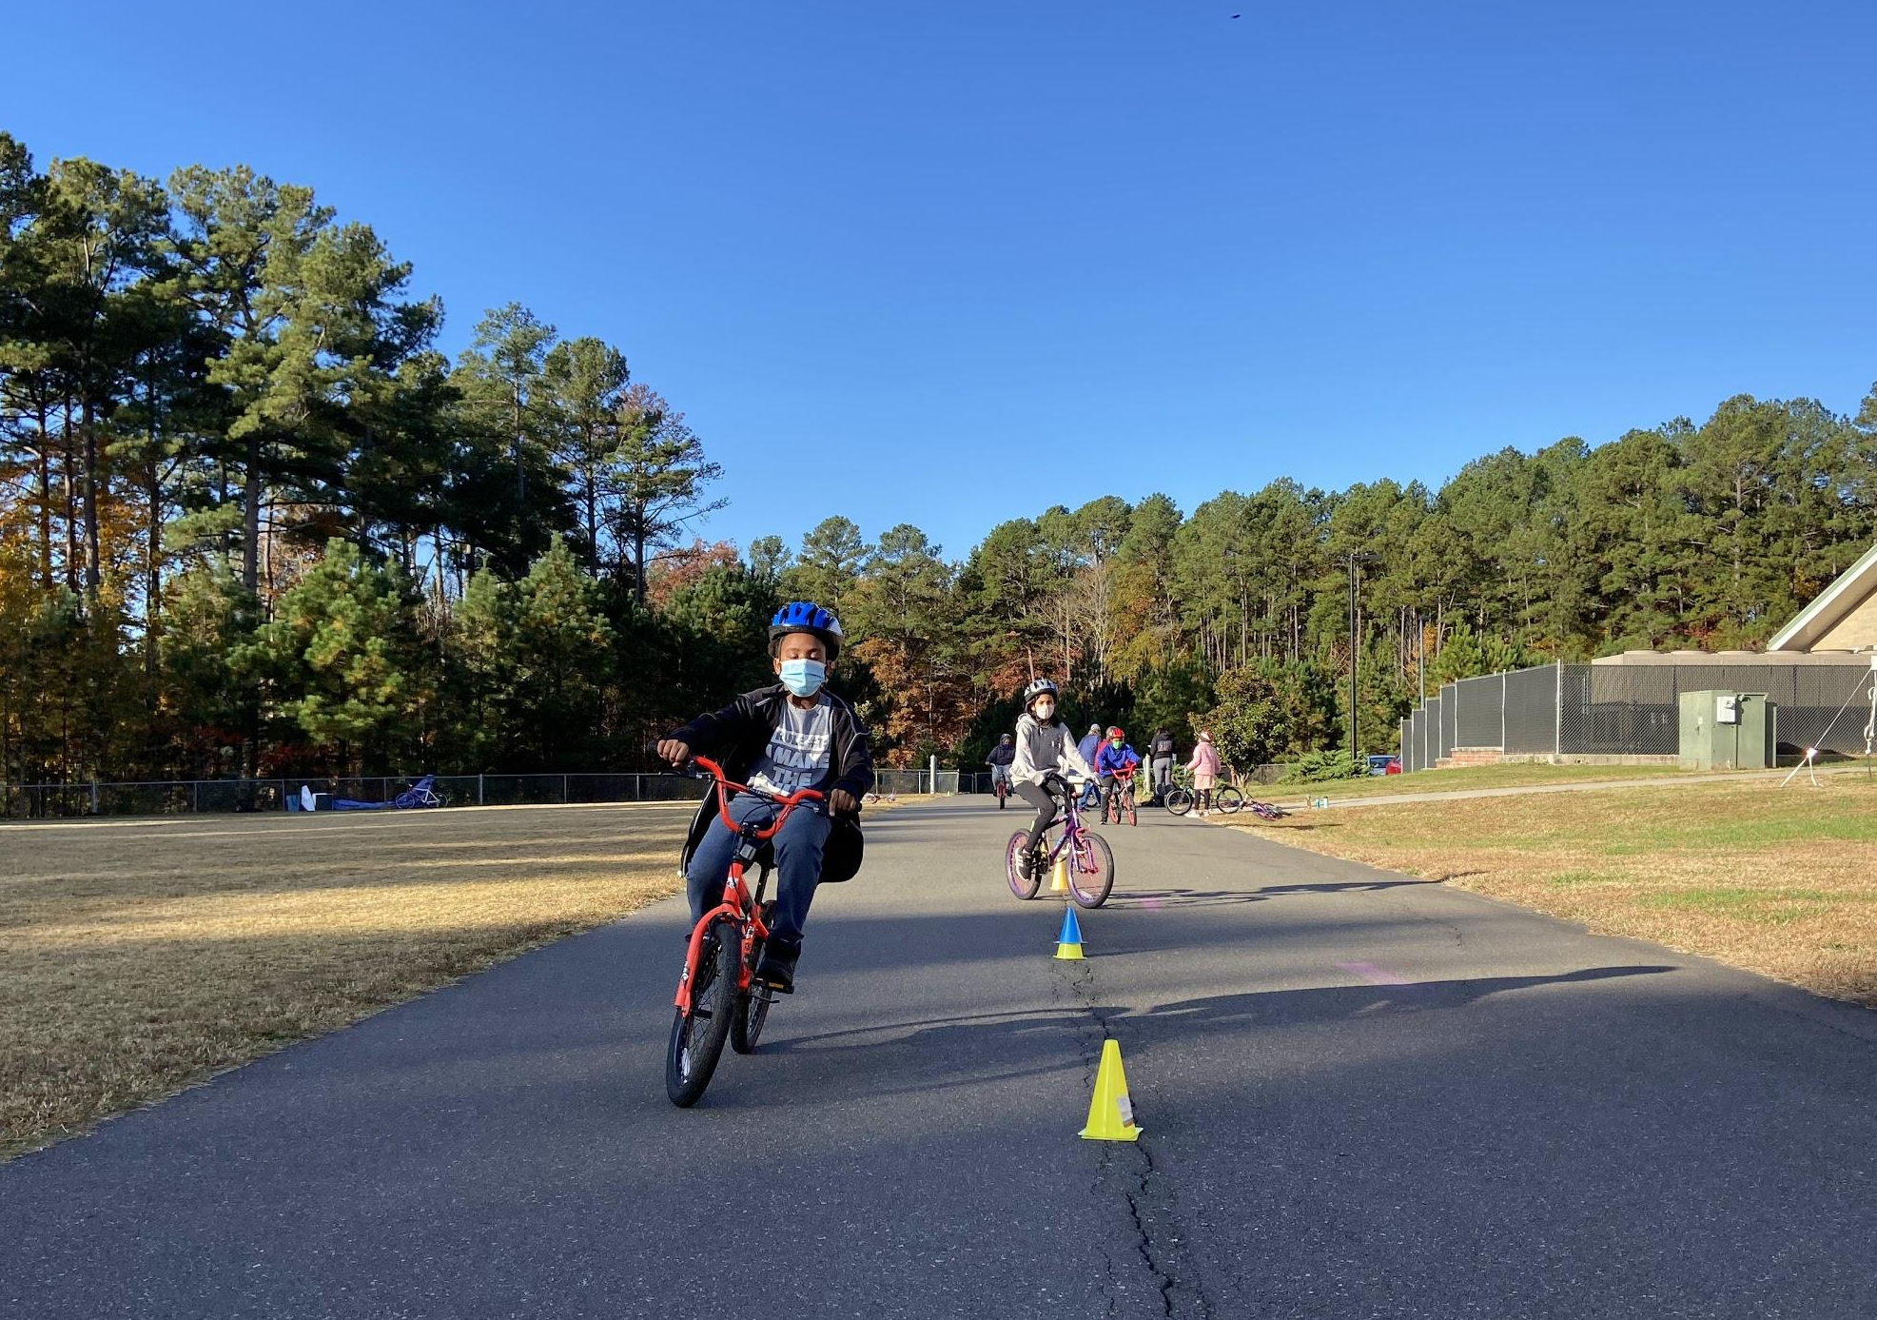
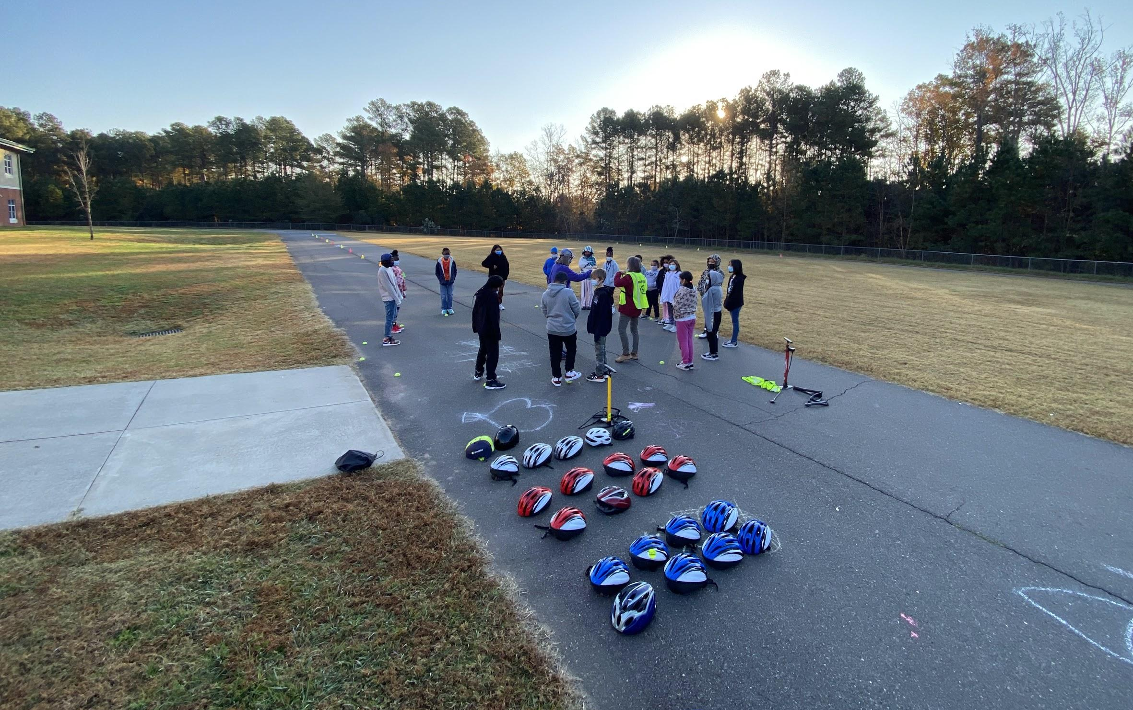
Bicycle Safety Course

Slide 15
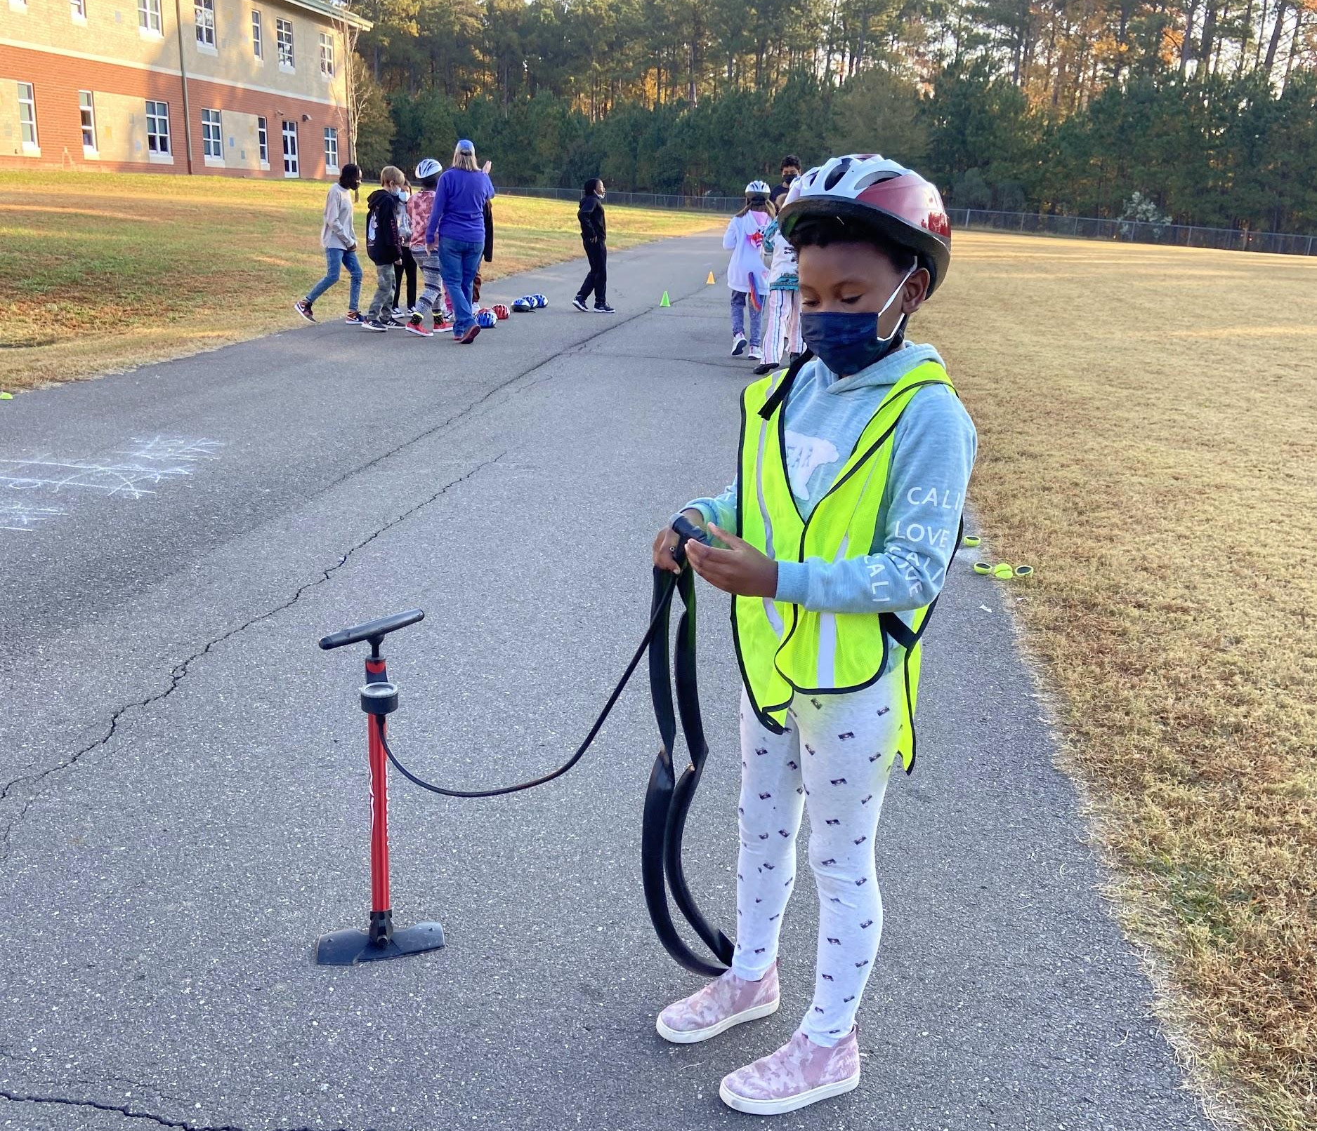
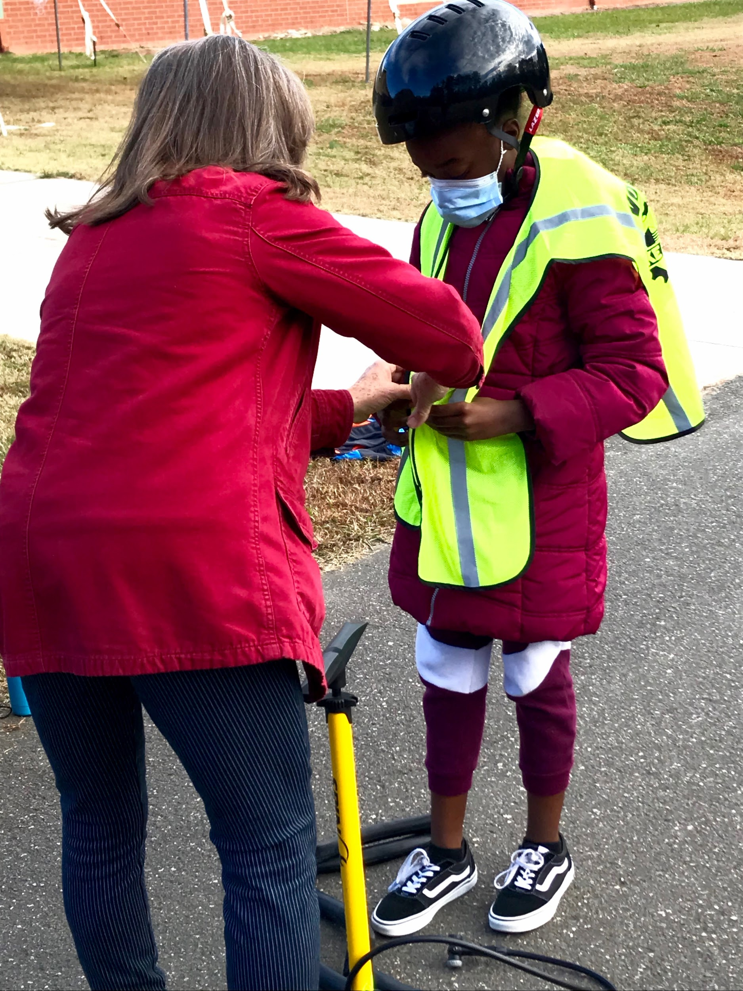
Bicycle Safety Course

Slide 16
Bicycle Safety Course
The Bike Safety course was better than I had expected. The instruction was very easy to follow and appropriate for this age group. The atmosphere during the course really helped our students build their confidence in riding bikes, especially the ones who had little to no experience. I would absolutely recommend this course to other schools for all grade levels. I look forward to having this program back at my school next year.
- Coach Wilson, PE teacher at Merrick-Moore Elementary

Slide 17
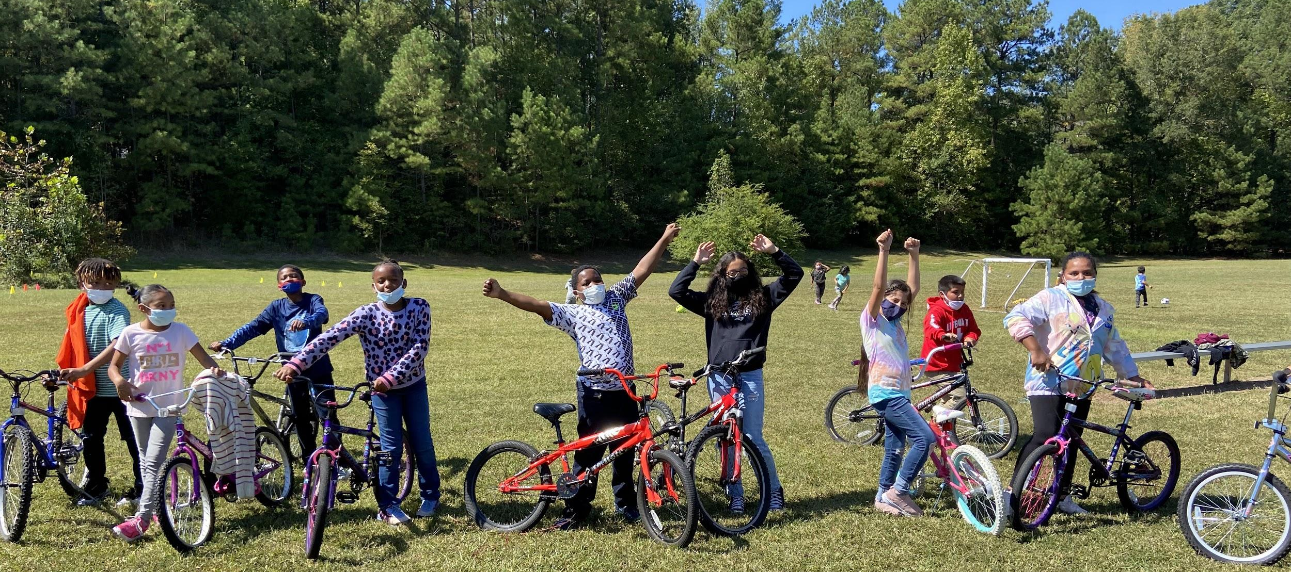
Bicycle Safety Course
I'm grateful for this community partnership with Bike Durham. Their expertise and resources have enabled Eastway to offer Bicycle Safety to our students for several years now. We were even able to host a bike workshop over the weekend recently that our students enjoyed immensely. I'm so grateful for this valuable partnership!
- Coach Watson, PE teacher at Eastway Elementary

Slide 18
What next?
Schools confirmed to complete Bike safety classes for 2022 school year 600 students served (6 schools)
Up to 20 schools to participate to the May walk bike to school event (up to 14’000 students)
Spanish speaking educators to be trained and added to the team for bike safety classes
Programming at Boys & Girls Clubs of Durham (summer 2022)
Ensuring programming reaches underserved schools and communities
Implement our ‘bikes giveaway’ program, where through the support and partnership with the Durham Bike Coop we provide free bikes and helmets to DPS students (30 delivered in 2021, aim for 120 bikes in 2022)

Slide 19
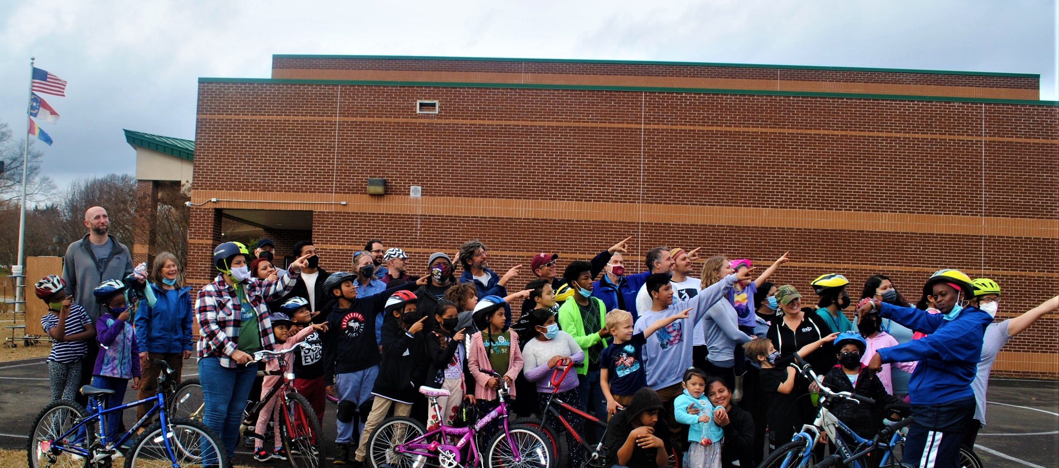
Future Impact
Deepening the partnership between DPS, the City and Bike Durham in order to bring easier access and equity to programming district wide.
Bringing greater visibility to programming
Including DPS leadership, community stakeholders, families and educators
Empowering students to be advocates and ambassadors for programming

Slide 20
Join Us in Creating Safe Routes to School
More info at bikedurham.org/safe-routes-to-school
Follow us on social media @bikedurham
Sign up for our emails at bikedurham.org/email-signup
Volunteer at bikedurham.org/volunteer
Questions in programming saferoutes@bikedurham.org
Notes:
This is Our Vision
Together We Can Create a Safe, Affordable, Sustainable Transportation System For Everyone Regardless of Who They Are or Where They Live

Slide 21
Questions & considerations

