Slide 1
BUYING BACK BETTER
How social housing acquisitions in London can tackle homelessness and help councils avert bankruptcy
ALEX DINER

Slide 2
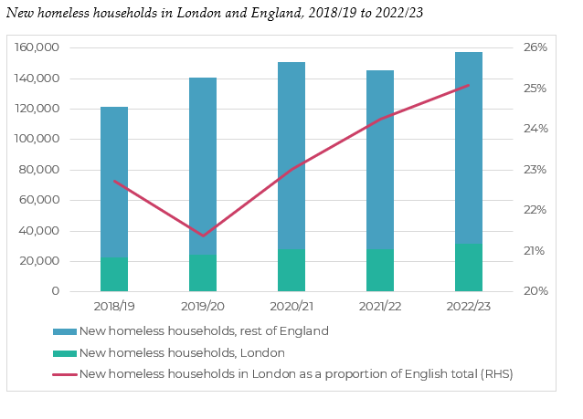
The scale of the homelessness crisis in London (1)

Slide 3
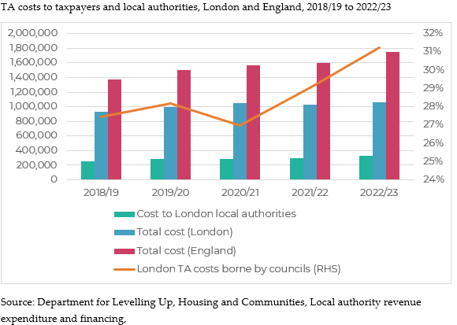
The scale of the homelessness crisis in London (2)

Slide 4
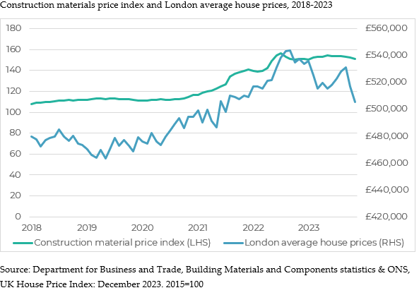
Why now is the time for acquisitions

Slide 5
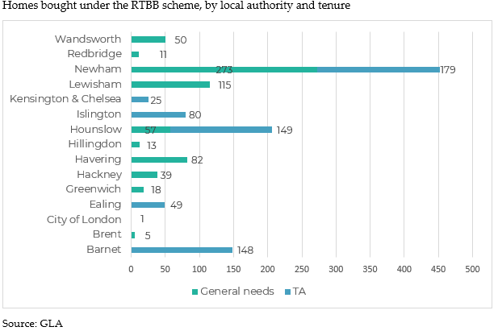
Right to Buy Back (RTBB): the headlines

Slide 6
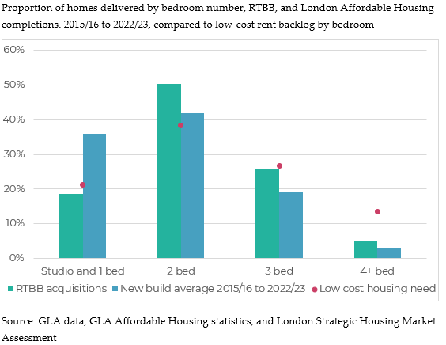
RTBB: matching purchases with need

Slide 7
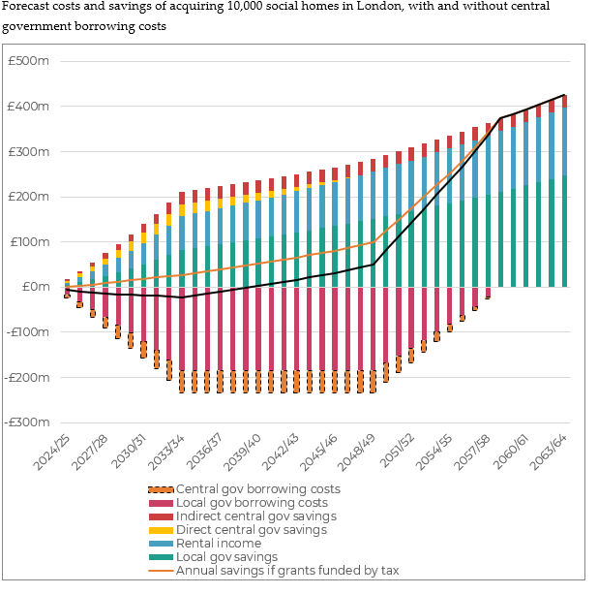

Slide 8
Recommendations
Commit to new AHP beyond 2026
National conversion fund to enable acquisitions across country
Raise 10% cap for HE grant to 30% used by GLA
Allow councils to combine right to buy receipts with other forms of grant funding, such as CHAP funding
Uprate TA housing benefit subsidy to current LHA
alex.diner@neweconomics.org

